Slide 1
Introduction to Pega
PRPC
Rajendra P Gaddam

Slide 2

Introduction
Pega Rules Process Commander(PRPC)
BPM Product
Built on Java
Product of Pega Systems

Slide 3
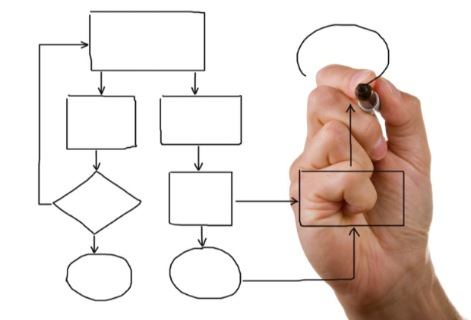
What is business process??
A collection of related structured activities or tasks.
Logic needed to perform the tasks.
Examples:
  Granting leave to Employees
  Paying salaries to Employees
  Recruiting resources

Slide 4
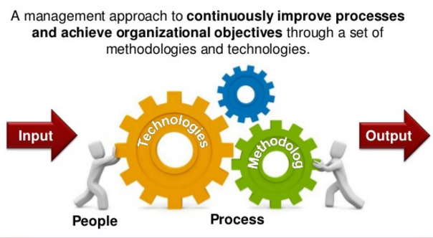
Business Process Management(BPM)
It is methodology wherein we manage various processes & work flows, that requires an organization to complete its business process work model.
BPMs are typically used to automate the business processes.
The key roles in BPM
  Technical IT team
  Business Team

Slide 5
Business Process Management continued…
The advantage of BPM is both business & IT teams have to work in collaboration & end result is achieving the business objective.
BPM is not about creating fancy UI or giving additional features
BPM is about building the solution for requirement, which is executable software

Slide 6
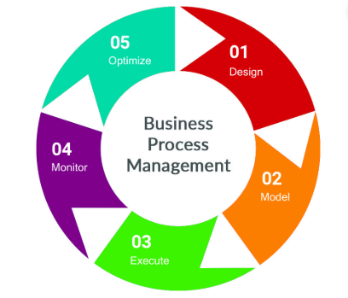
BPM Life Cycle
Analysis & Designing
Modelling
Execution
Monitoring
Optimization

Slide 7
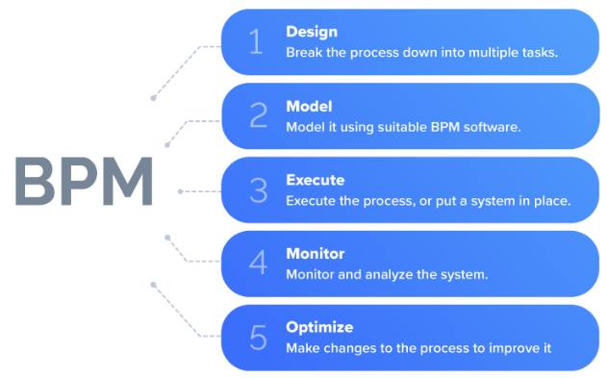
Analysis & Designing
Analysis
Designing
Done by group of business users & business architects.
Dive into business requirements
what & why & where need to be done
Done by business architects
Its high level model without any execution construct & which is missing implementation
Need to define high level business process model, which contains
    Process involved
    Wireframes
    Integration
Business team designs should be reusable & convert in to executable construct.

Slide 8
Modelling
The high level business process model & wireframes designed by business architect are converted into executable construct by IT team by defining..
Data Elements
Executable Flow diagrams
UI forms
Reports
Build an application to run in real-time

Slide 9
Execution
Testing an application to check how the application works
IT & BA & Testing teams comes into picture
Make sure that process is error-free
End-to-end result is delivered??

Slide 10
Monitoring
After the application is deployed
Monitor the application to check
  Performance
  Is UI designed as needed
  Is implemented as per requirement
  Is it working as expected
Happens periodically
Business users identifies changes required to do improve performance

Slide 11
Optimization
Do the changes as per the business users requirement by
  Analyze the gaps encountered
  Checking the feasibility
It should not affect the actual process
Business users identifies changes required to do improve performance or in terms of reusability

Slide 12
BPM Key Factors
  Minimal coding requirements
  Pre-Configured Code
  Less time to build applications
  Minimal team size
  More Profitability

Slide 13
BPM Competitors
  Oracle BPM
  Tibco
  Cordys
  Appian
  Lombardi
  Savvion
  Metastorm :ework

Slide 14
Why Only Pega??
  Minimal coding requirements
  Built-in process and business rules & functions
  Out-of-the-box tools for tracing and debugging
  Object-oriented rules base, enabling reuse of rules
  Automation of database connections, Web Services integration capabilities
  Ease of deployment; real-time changes to existing rules
  Build Once, Use it on multiple devices
  Development is 5.5 times faster using Pega BPM than Java
  Making business changes using Pega BPM is 6.8 times faster than Java
  Integration activity using Pega BPM is 28 times faster than with Java
  Deployment using Pega BPM is 5 times faster than with Java
  Support for most of the databases & application servers

Slide 15

Pega Industry Presence
  Banking
  Healthcare
  Insurance
  Credit Cards
  Manufacturing
  Communication
  Government

Slide 16
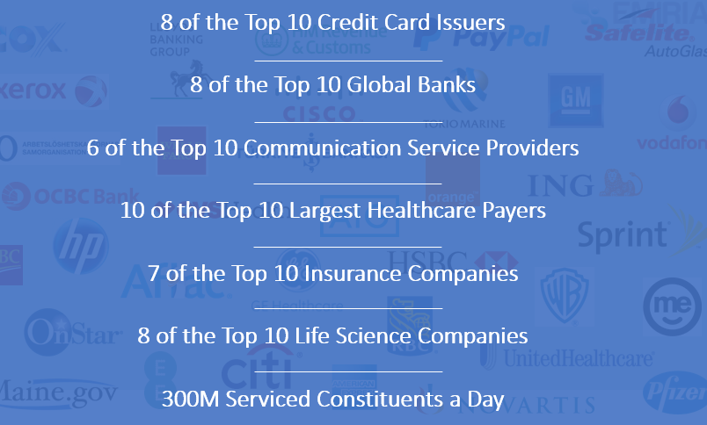

Slide 17

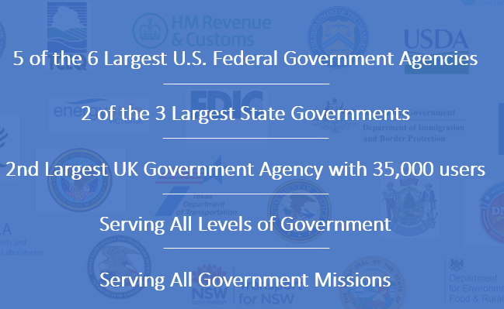

Slide 18
Pega Versions
  8.5 latest version
  8.1 in 2018
  7.3
  7.1 in 2014
  6.3
  6.2
  6.1 in 2010
  5.5
  5.4 in 2006

Slide 19
Prerequisites
  JDK
  Application Server ( Tomcat / Weblogic / Websphere / Jboss)
  Database(Oracle / MSSQL / My SQL / Post-Grey SQL / IBM DB2 )
  Minimum of 8 to 16 GB RAM
  60 GB HDD

Slide 20
Pega Editions
  Personal Edition
  Enterprise or Professional Edition

Slide 21
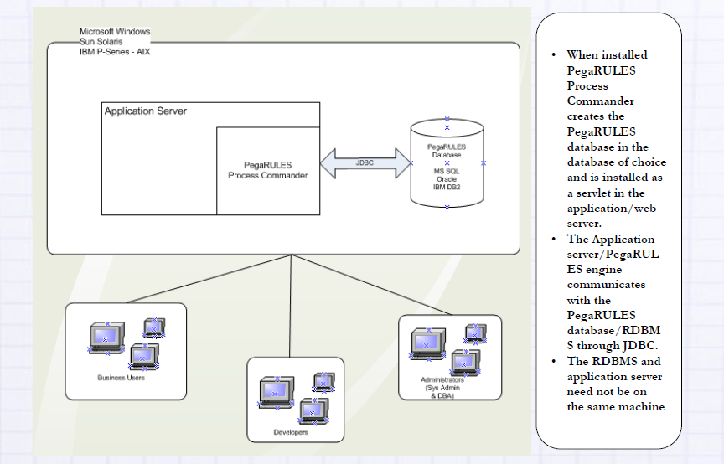
Pega Architecture

Slide 22
Pega Infinity
PRPC
Rajendra P Gaddam

Slide 23
Pega Infinity Application Platform
  Provides a single, unified platform to build or modify enterprise applications
  Business and IT stakeholders work together to capture business requirements
  No/less coding required
  Automatically generates the application and its documentation

Slide 24
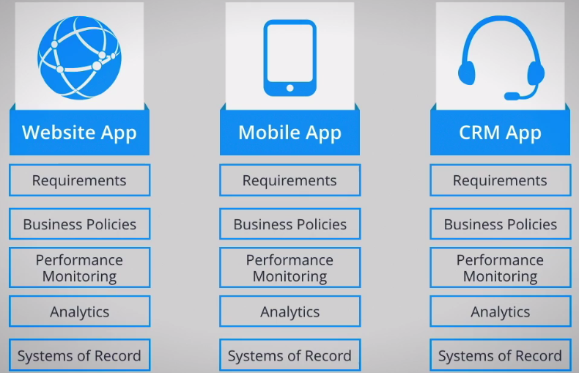
Traditional Application Development
Focus on creating individual business applications
Individual applications must be integrated with each other
Each application has its own requirements, analytics, business policies, tools, and repositories
Sharing and reusing application components is difficult

Slide 25
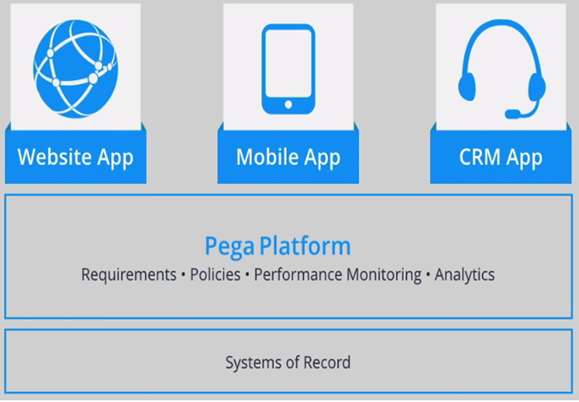
Pega Unified Application Development
Functionality is configured using a consistent set of components
Components are defined and stored together
One System of Record
Common set of tools
Model-based application design & development approach
Sharing and reusing application components is Easier

Slide 26
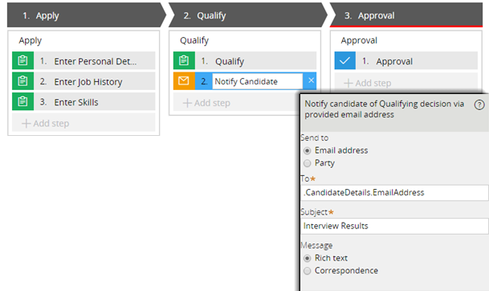
Model-based Application Design
Ensures visibility among all team members to an overall application
No coding is required
Team members can also identify potential gaps
As a result, updating processes, user interfaces, and other business rules is easier

Slide 27
                THANKYOU

